Slide 1
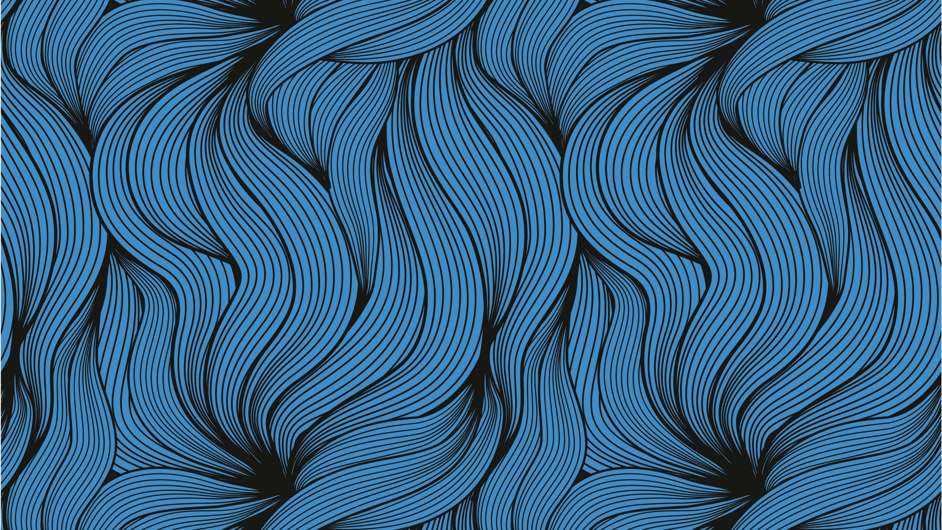
Production Log
LAC – Produce a website for a specific purpose and audience.

Slide 2
Asset list
Name | Filer Type | File Size | Source
arrow | .svg | 1.47kb | me
Bracket L | .png | 88.2kb | me
Bracket R | .png | 88.8kb | me
Bull screenshot | .png | 2.29mb | Cuphead website (iam8bit)
Carrot boss | .png | 115kb | Cuphead wiki
Ch mm netflix | .png | 730kb | Netflix
Cupehad potato fight | .jpg | 274kb | IGN
Cuphead carrot fight | .jpg | 159kb | IGN
Cuphead edited transparent | .png | 215kb | me
Cuphead marching | .png | 434kb | Cuphead website (further edited by me)
Cuphead onion fight | .jpg | 126kb | IGN
Cuphead show logo | .png | 85.5kb | Netflix
Cuphead the jazz os cuphead | .png | 1.17mb | Game music festival website (further edited by me)
Cuphed-mumgn-brothers | .png | 230kb | Cuphead website
Delisious last course people edited | .png | 872kb | Cuphead website

Slide 3
Asset list
Name | File Type | File Size | Source
Dragon fight cuphead | .jpg | 113kb | IGN
Flower bg | .png | 1.25mb | Internet archive “the art of cuphead” (further edited by me)
Frog bg | .png | 1.83mb | Internet archive “the art of cuphead” (further edited by me)
Ice screenshot | .png | 2.58mb | Cuphead website (iam8bit)
Ilse 1 map | .png | 1.12mb | Internet archive “the art of cuphead” (further edited by me)
Mortimer Freeze | .png | 10.3kb | me
Mug man edited transparent | .png | 206kb | me
Onion cuphead | .png | 149kb | Cuphead wiki
Paper texture | .png | 3.61mb | unsplash
Steam logo | .png | 210kb | Steam (further edited by me)
Switch logo | .png | 6.11kb | Nintendo (further edited by me)
Xbox logo | .png | 72.8kb | Xbox (further edited by me)
Ps logo | .png | 18.8kb | Playstation (further edited by me)
Untitled-1 | .png | 10.5kb | me
Cuphead Video | .avi | 269mb | me
Cuphead show trailer | .mp4 | 11.7mb | netfliix
Floral fury | .mp4 | 18.4mb | YouTube
Flower fight | .mp4 | 27.3mb | youtube

Slide 4
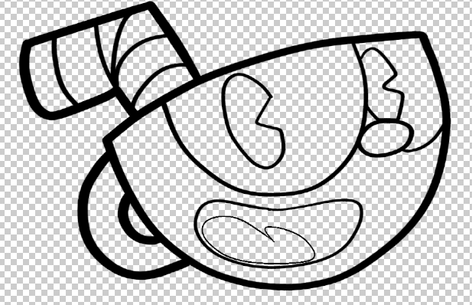
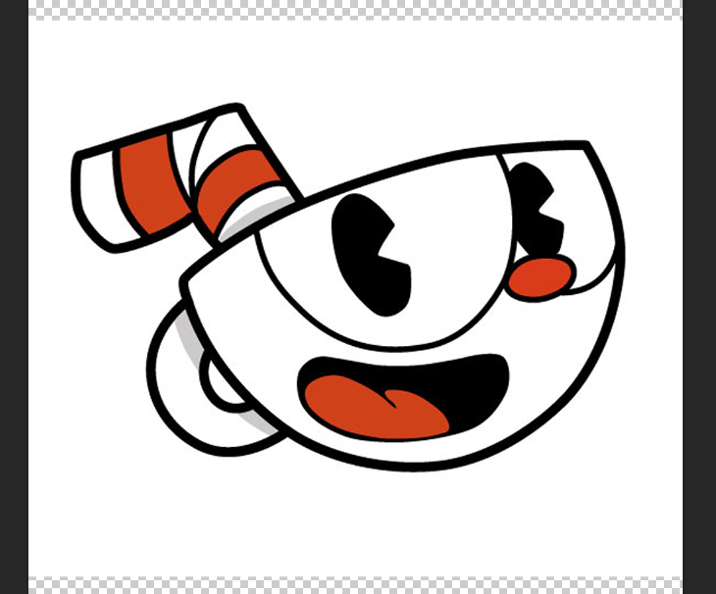
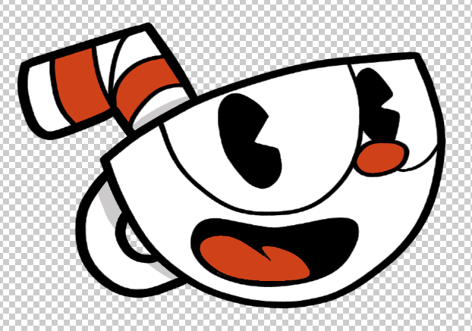
Recreating images in vectors for scalability
before
after

Slide 5
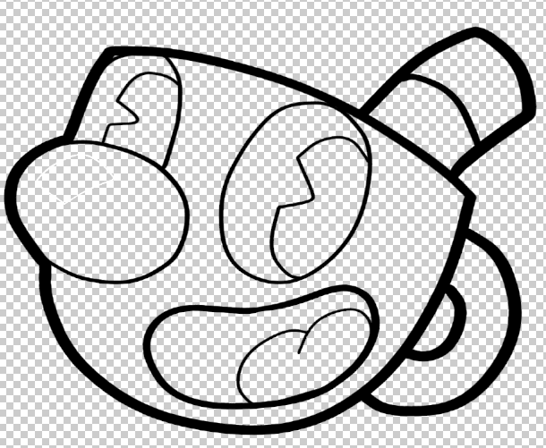
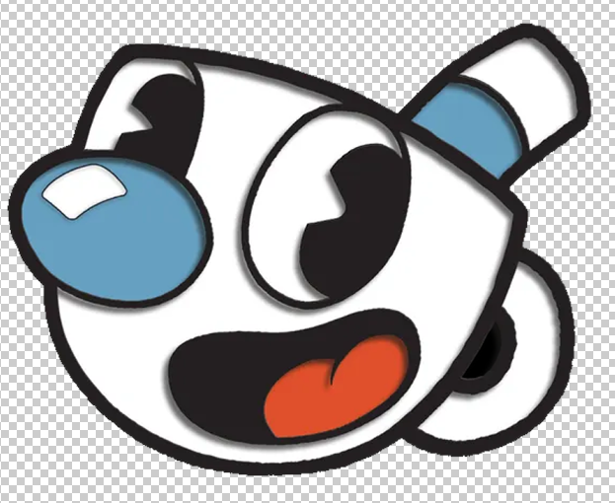
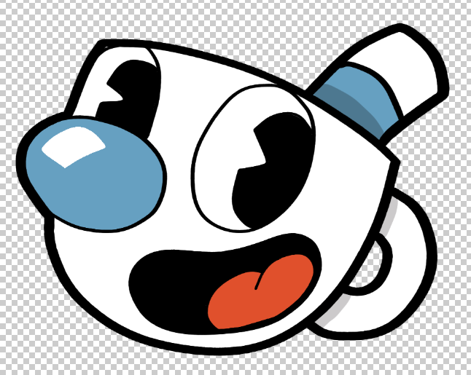
Recreating images in vectors for scalability
before
after

Slide 6
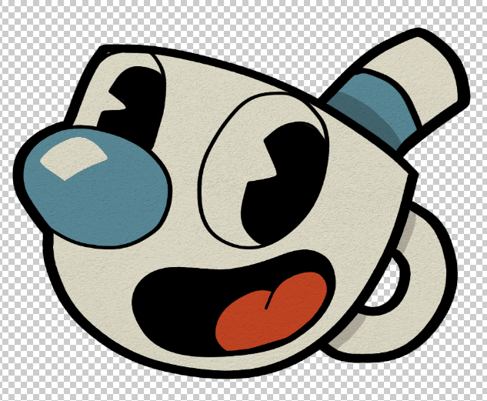
Further editing images with ages and paper textures
before
after

Slide 7
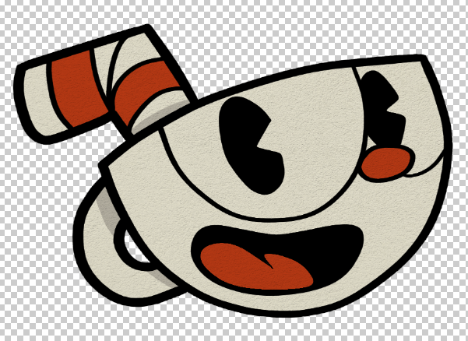
Further editing images with ages and paper textures
before
after

Slide 8
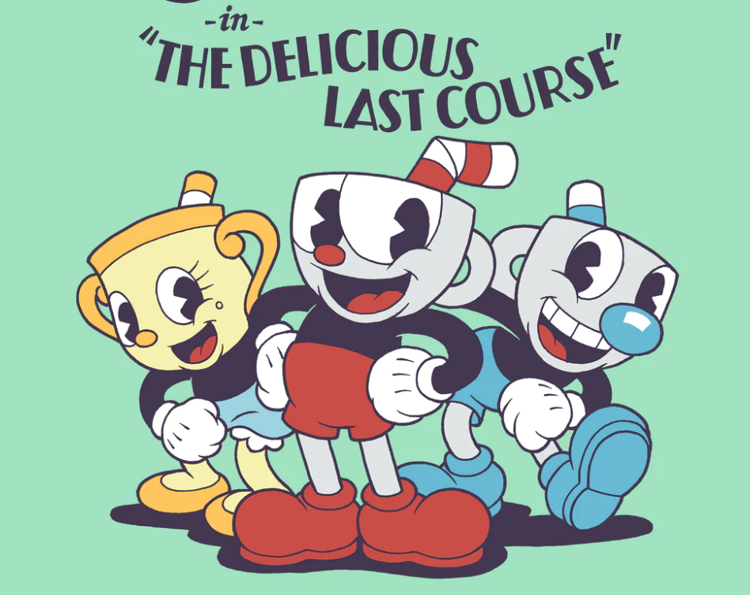
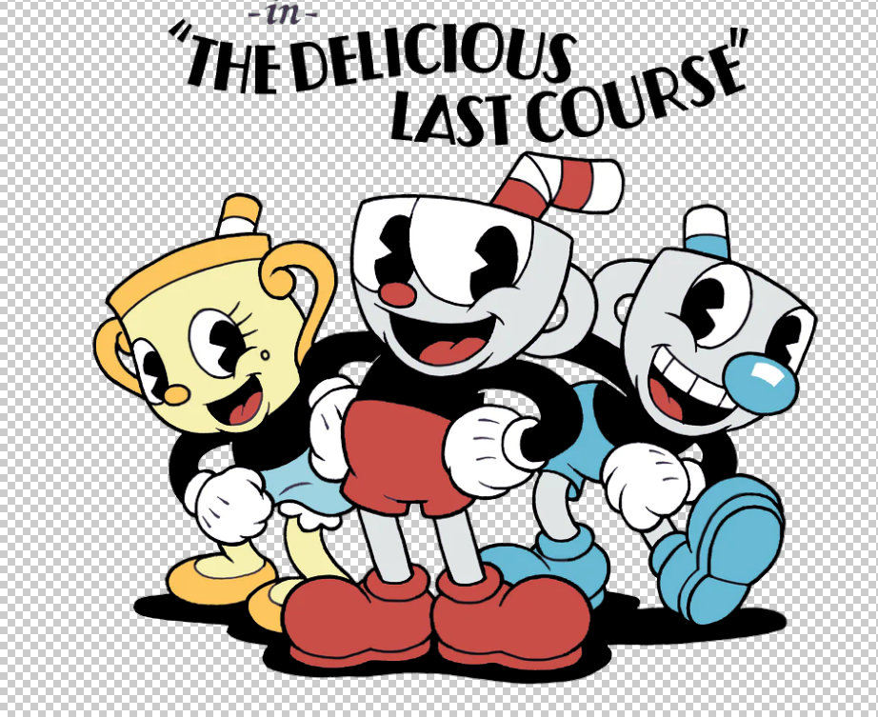
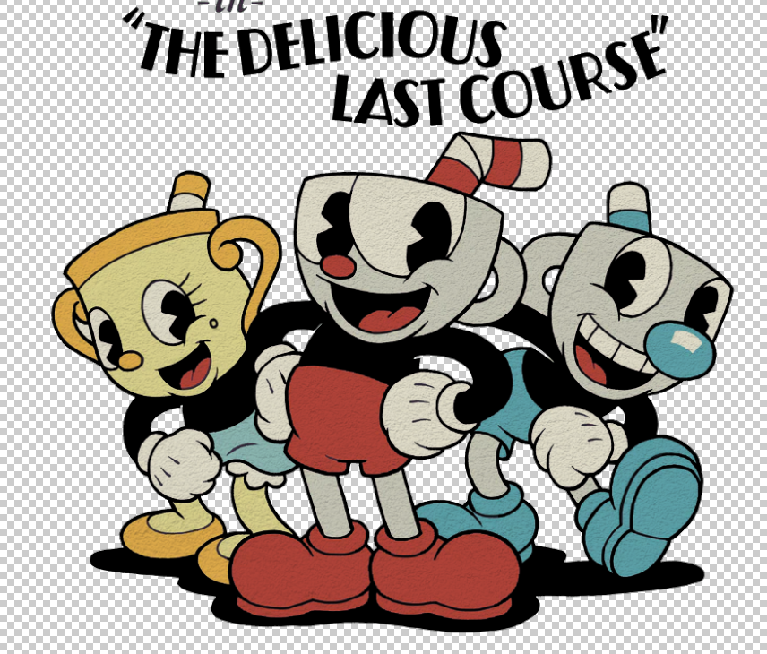
Editing colour of outline to make it stand out more + remove background + ageing
before
after

Slide 9
Justify final asset choice and preparation techniques applied in terms of purpose and audience
Justify final asset choice and preparation techniques applied in terms of purpose and audience – see slides 4 – 9 for images and 17 – 23 for video justification of preparation techniques
I feel that I have fully justified my assets used in their connection to my audience and how they are presented on my website alongside each other, other parts of my website and the fonts used on my website. During the creation. the assets have been selected to fit the theme of retro along with cartoonish look, this has been done to fit the theme of the music and game I have chosen along with mixing nostalgia of old cartoons into the look of the website.

Slide 10
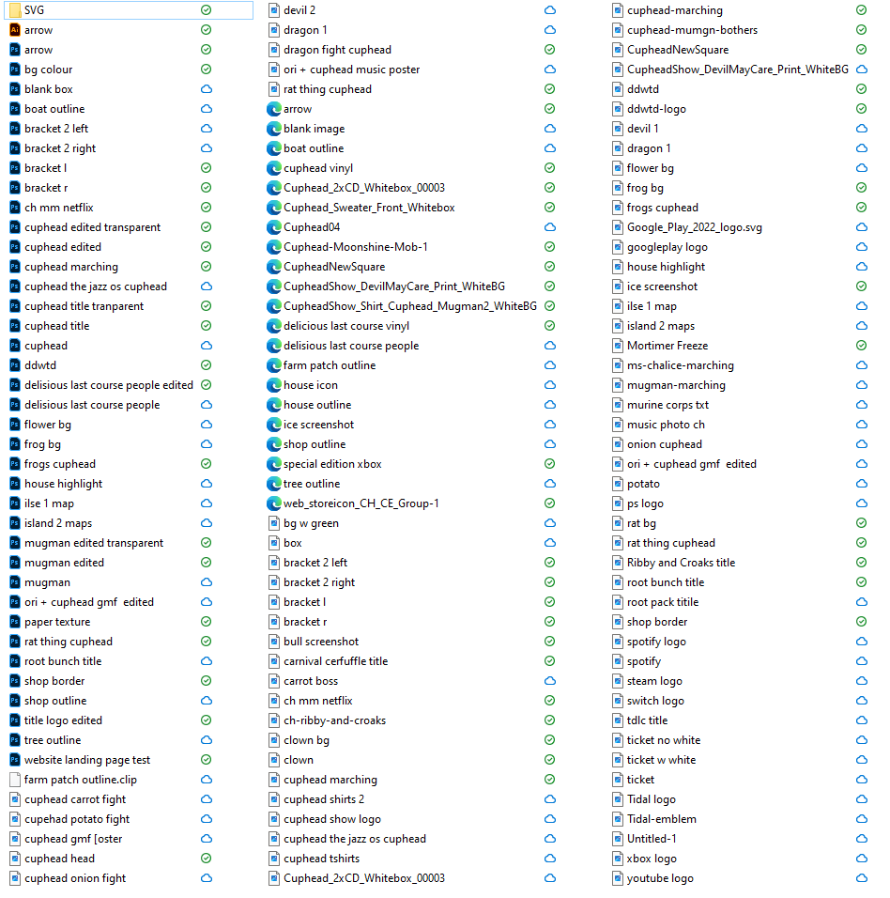
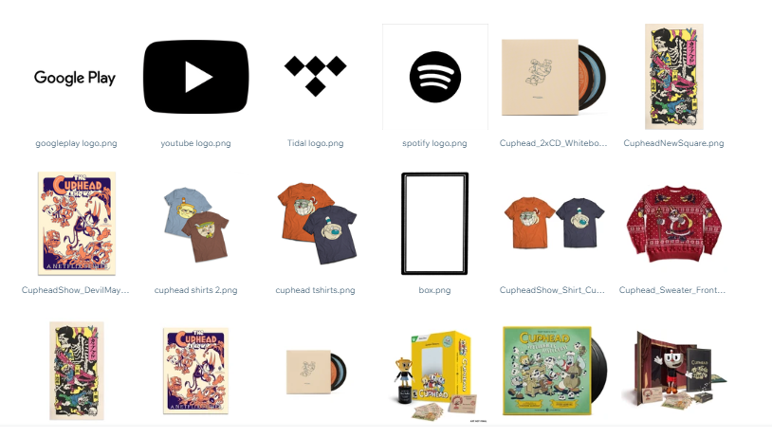
File Management, Structure and Organisation

Slide 11
Metadata

Slide 12
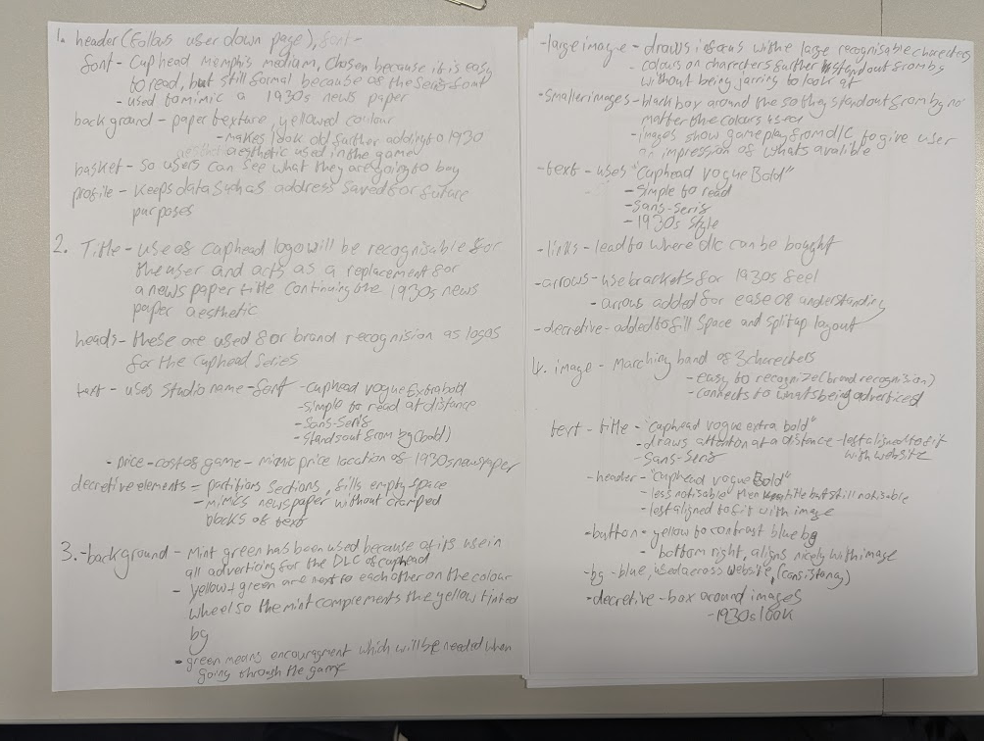
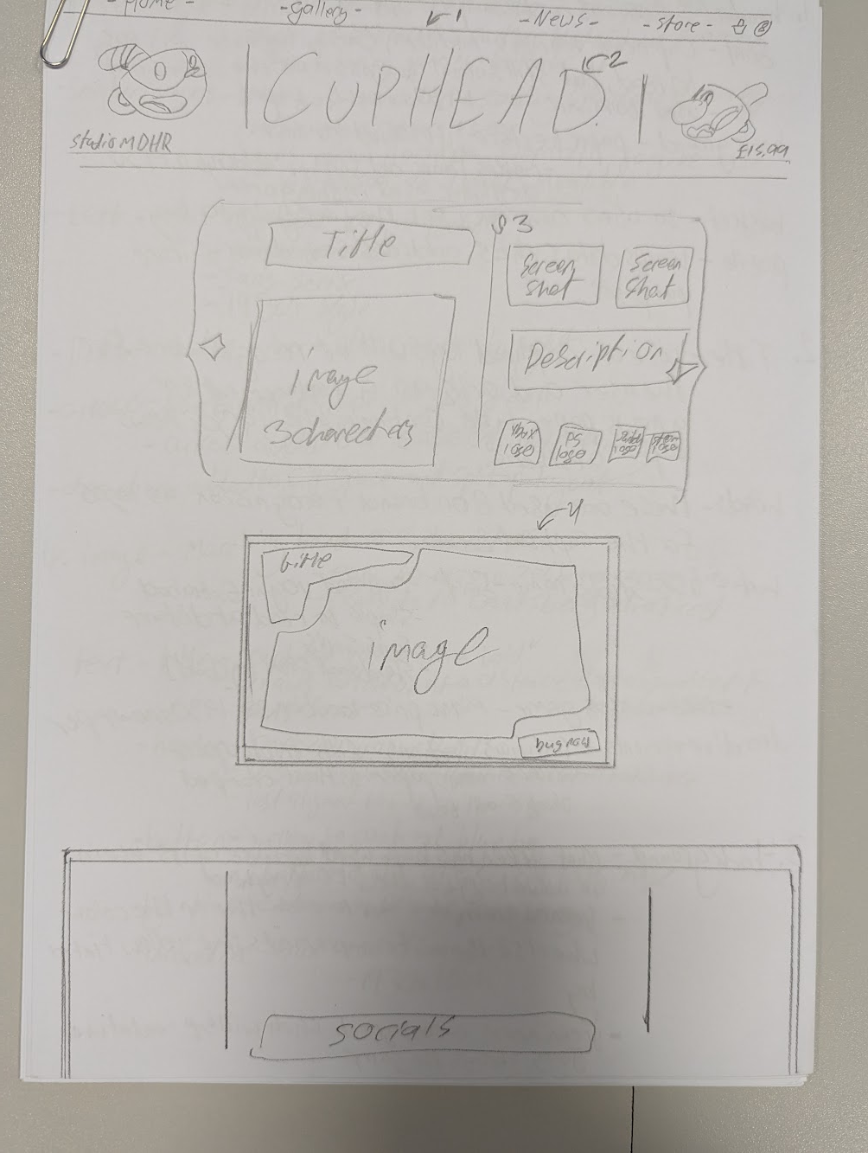
Page layout, including text and image (Page 1)

Slide 13
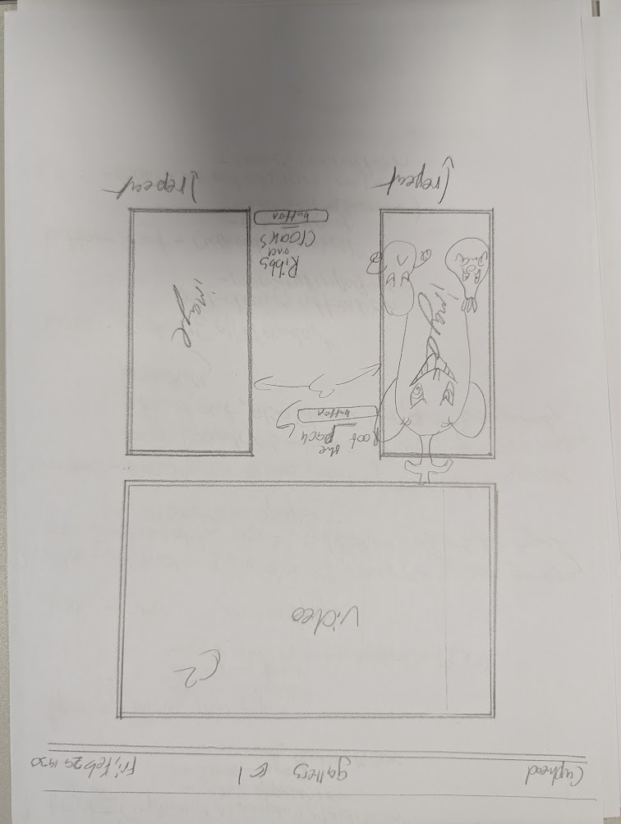
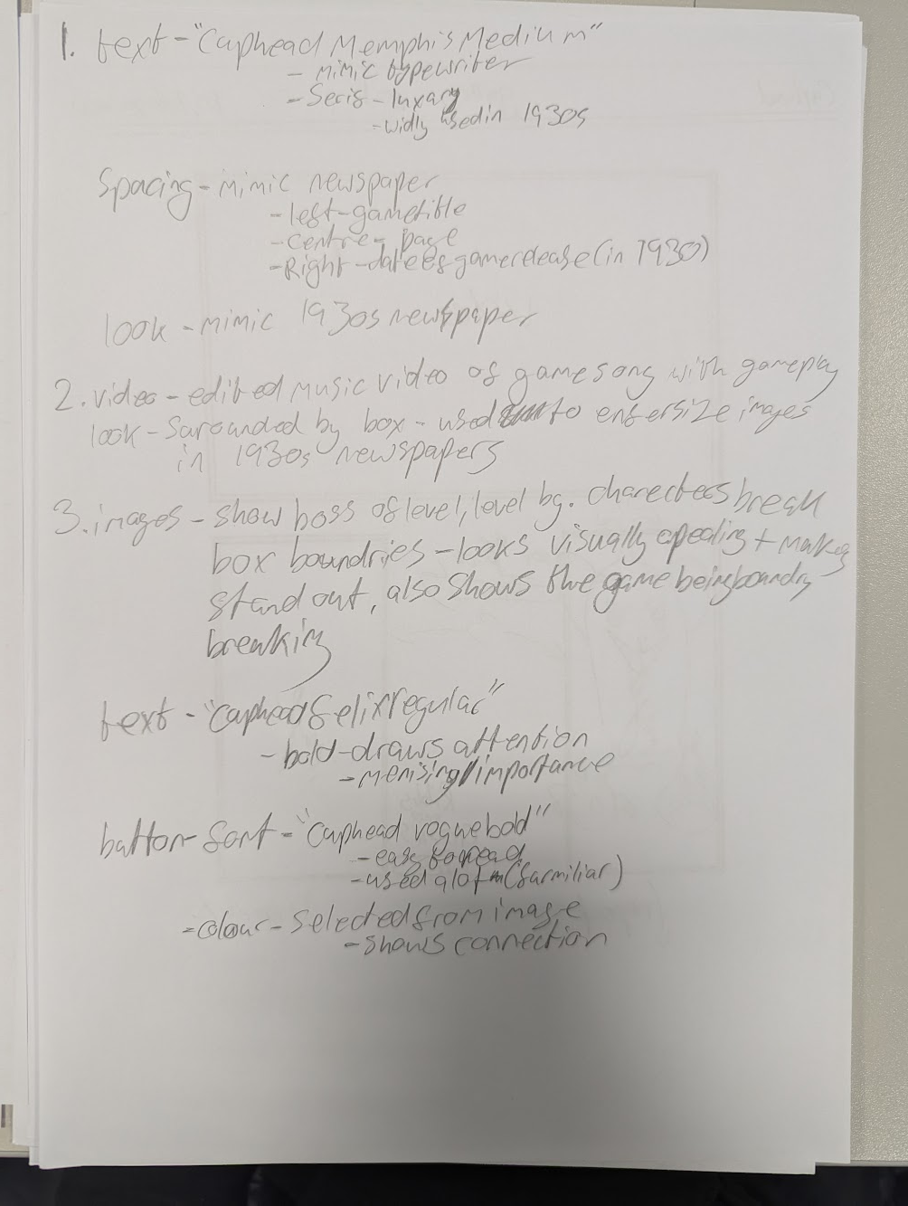
Page layout, including text and image (Page 2)

Slide 14
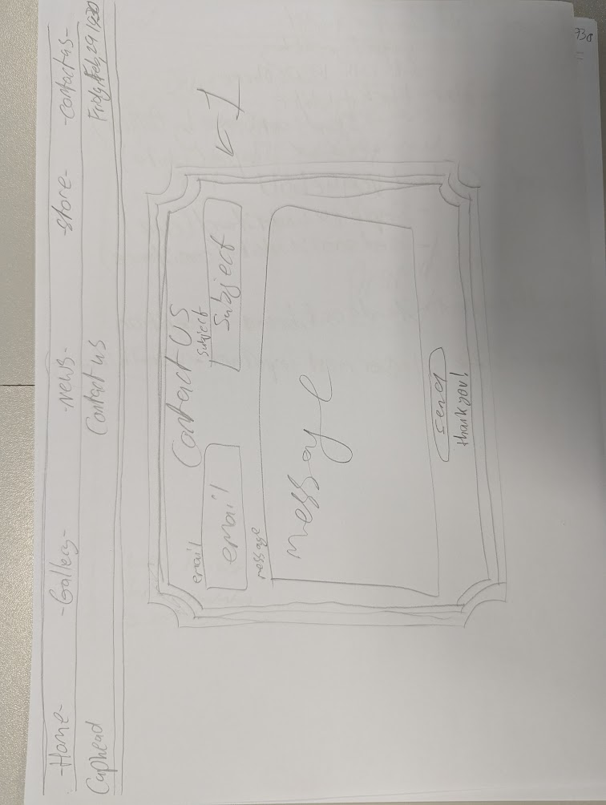
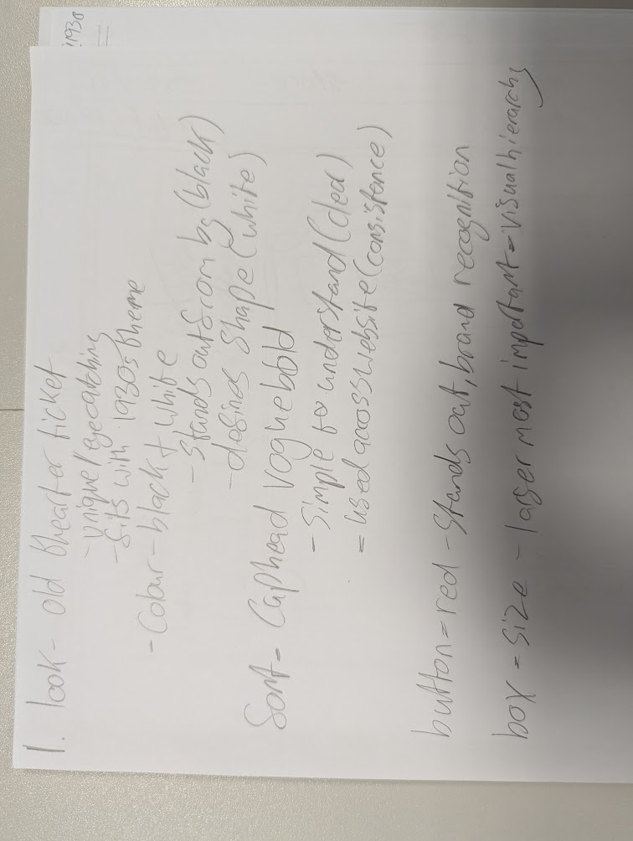
Page layout, including text and image (Page 3)

Slide 15
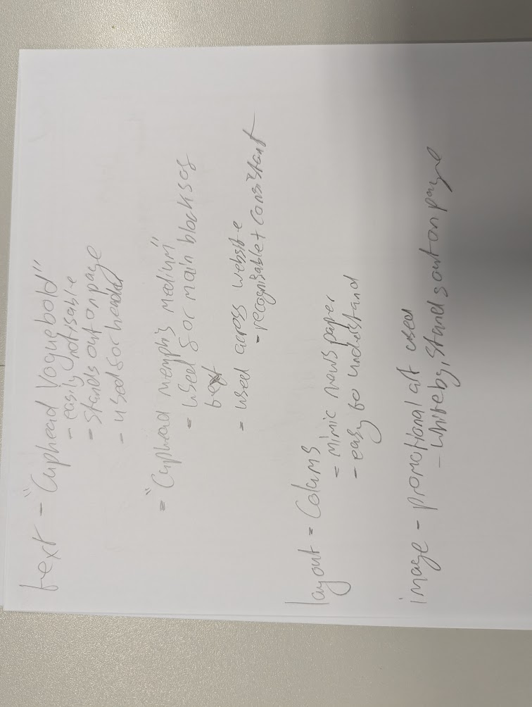
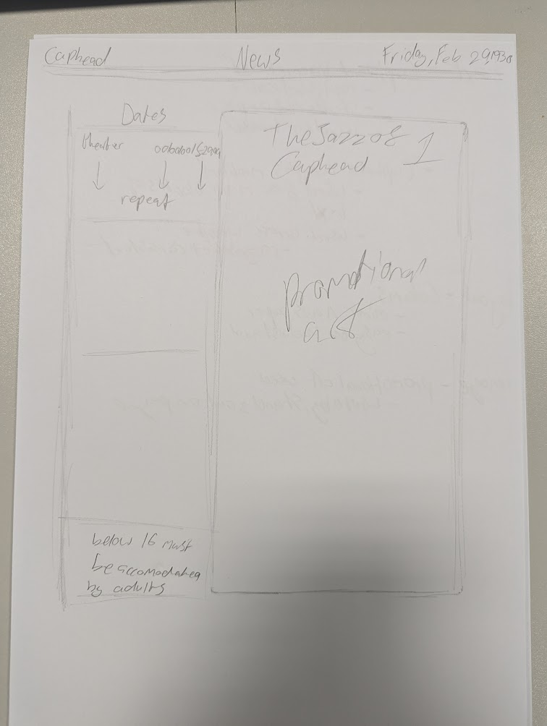
Page layout, including text and image (Page 4)

Slide 16
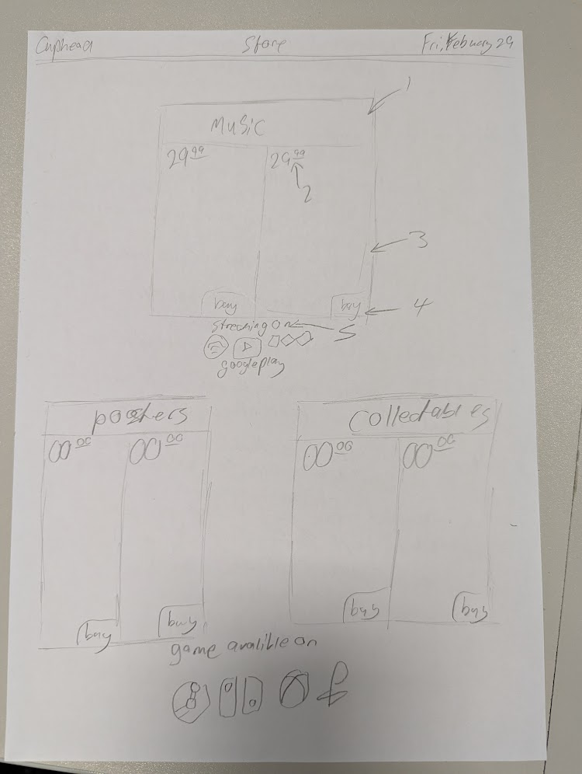
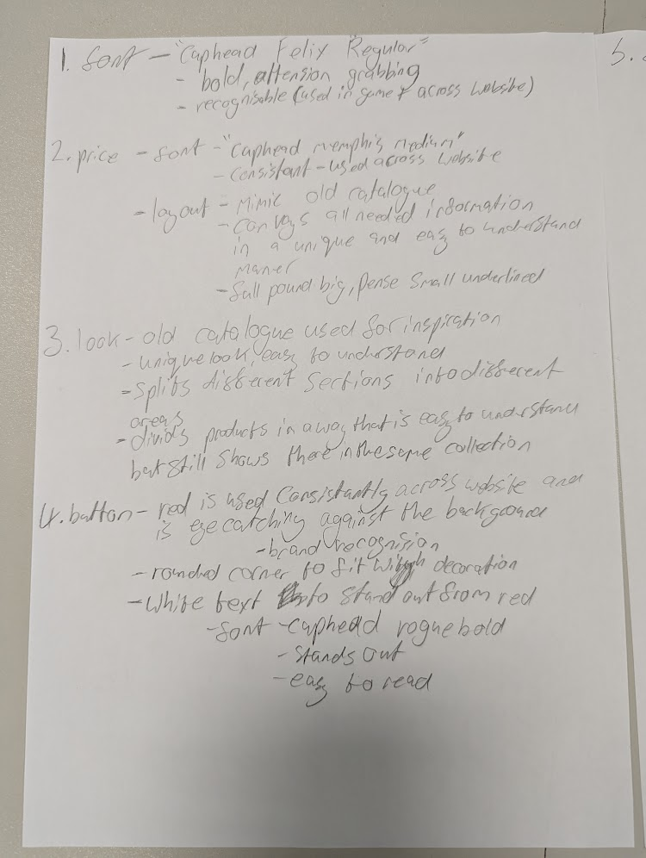
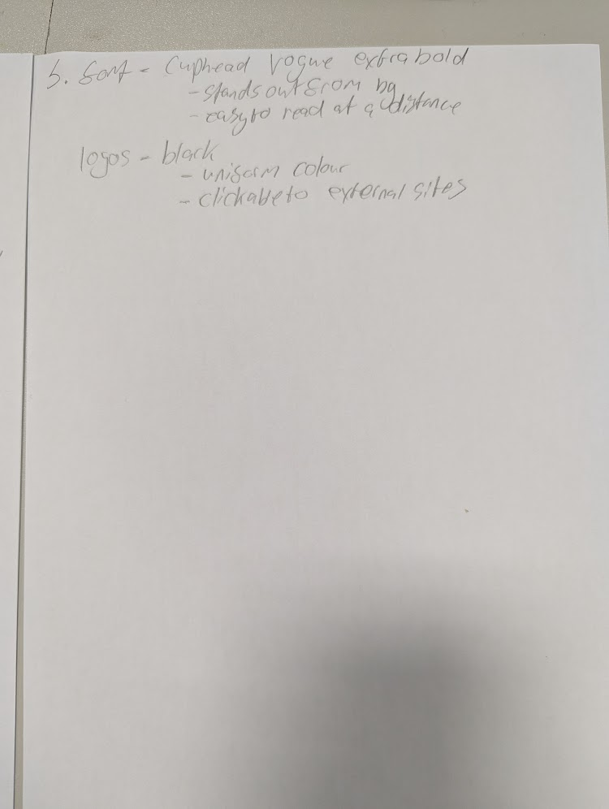
Page layout, including text and image (Page 5)

Slide 17
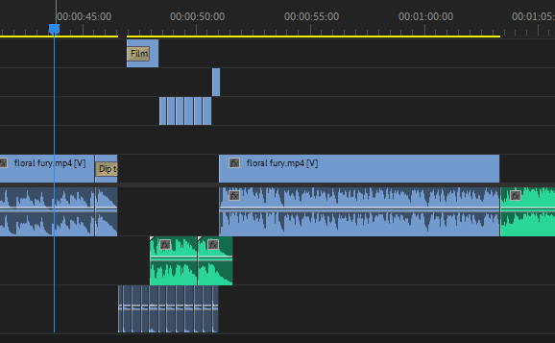
Video
I have cut up game play from a large section to switch between on beat with the music, I have also cut on the clicks to more easily place the game play

Slide 18
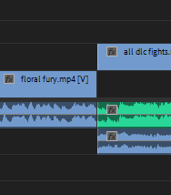
Video
Transition between video audio and song audio

Slide 19
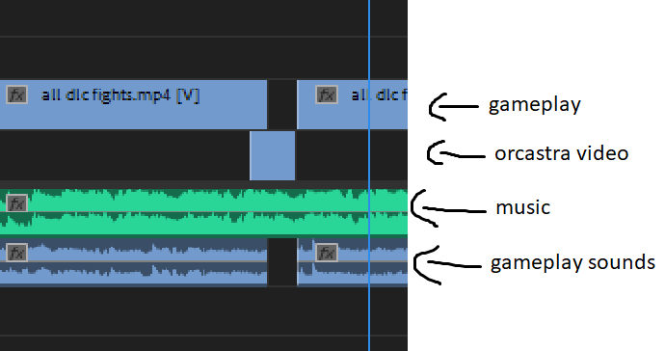
Video
Swapping between 2 videos to keep the video interesting

Slide 20
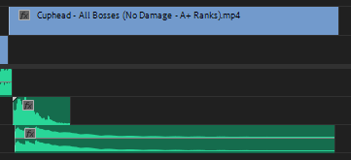
Video
Song cuts out as boss is defeated and end section plays

Slide 21
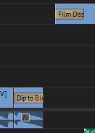
Video - transitions
Transition bettween gameplay and video (to make it not jarring to look at) by using "dip to black" makes static of gameplay fade in with "film dissolve

Slide 22
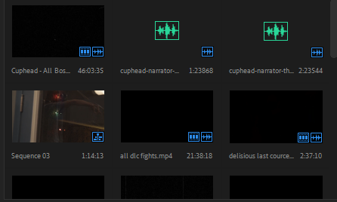
Video - importing
Video and audio have been imported to use in the video

Slide 23
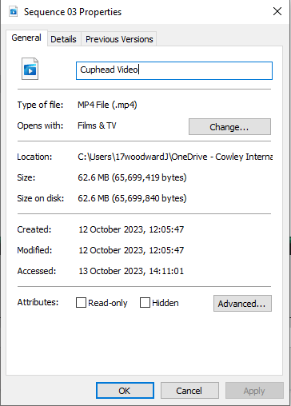
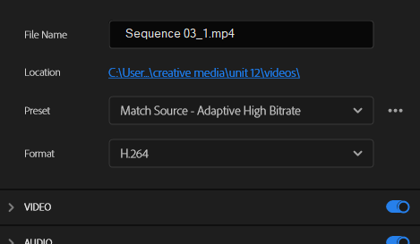
Video - exporting
Video was exported in H.264 format to keep quality even if it has a larger file size

Slide 24
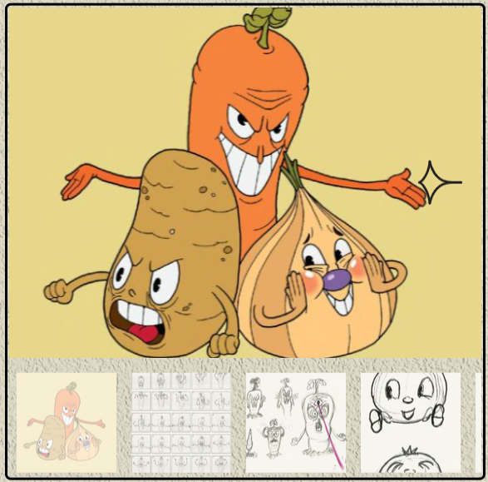
Interactive gallery
An interactive gallery has been added so the user can look at concept art and other art based around the subject of the page, so for this page which focused on "the root pack" it shows concept art the user can look through as they choose

Slide 25
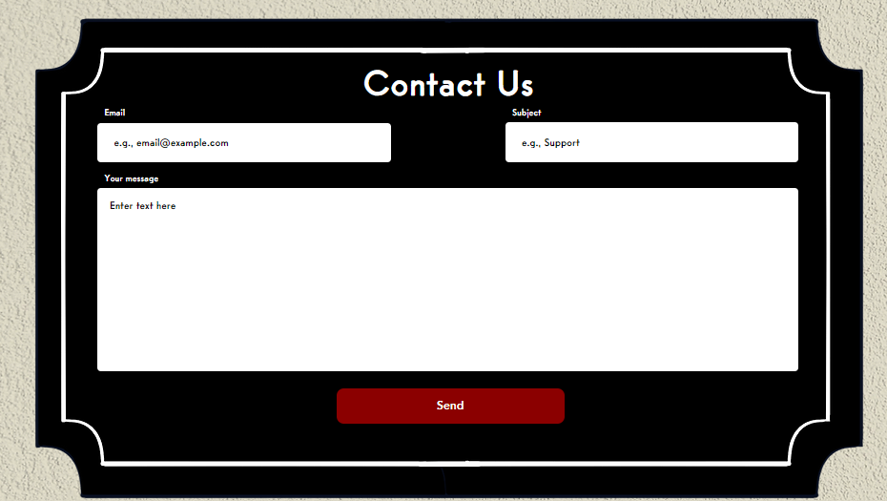
Form
A form has been added to the website so users have an easy way to send feedback, ask questions and report bugs. This makes it much easier for things to be fixed and builds a connection with the user

Slide 26
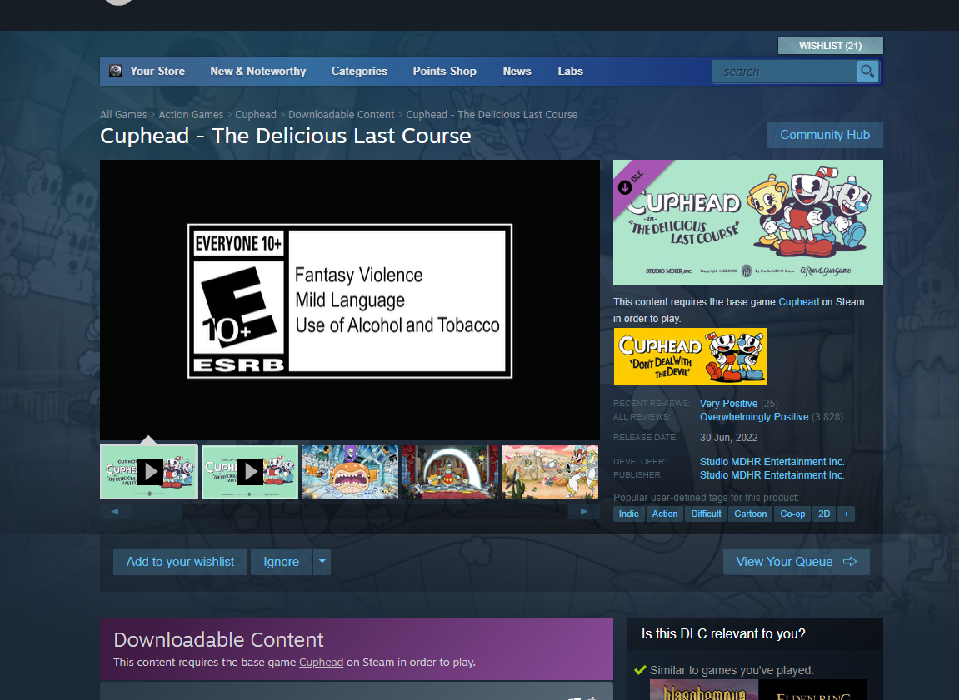

Link to external file / content
I have use external links to give the user access to buys things on other sites which arnt available on my own, such as digital copies of content

Slide 27
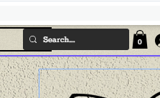
Search function
A search bar has been includes so the user is able to navigate the website and gain access to specific items or content on the website

Slide 28
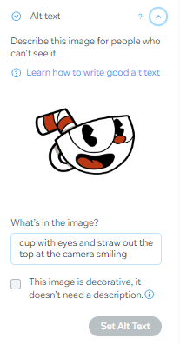
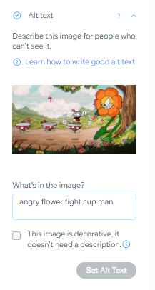
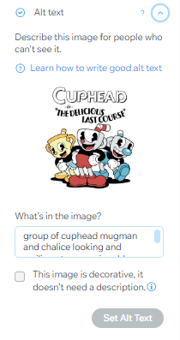
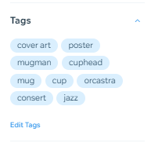
Accessibility - Use of Alt Tags on Images
Alt text has been added to help those who have issues with vision so that a screen reading is able to describe the image to then rather then them seeing it, this makes it much easier for them to navigate the website

Slide 29
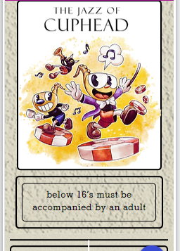
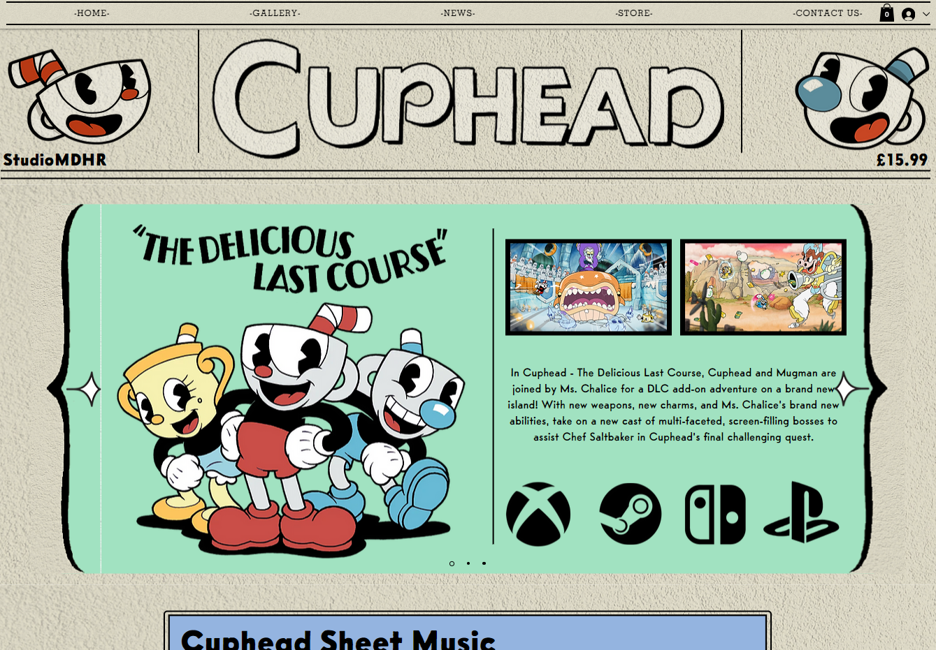
Viewed in two different browsers
Mobile
PC / Laptop

Slide 30
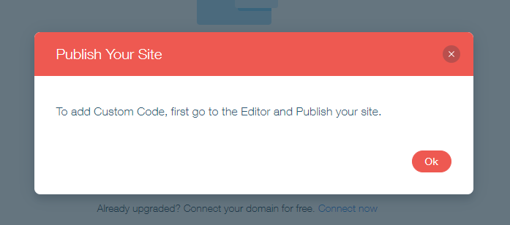
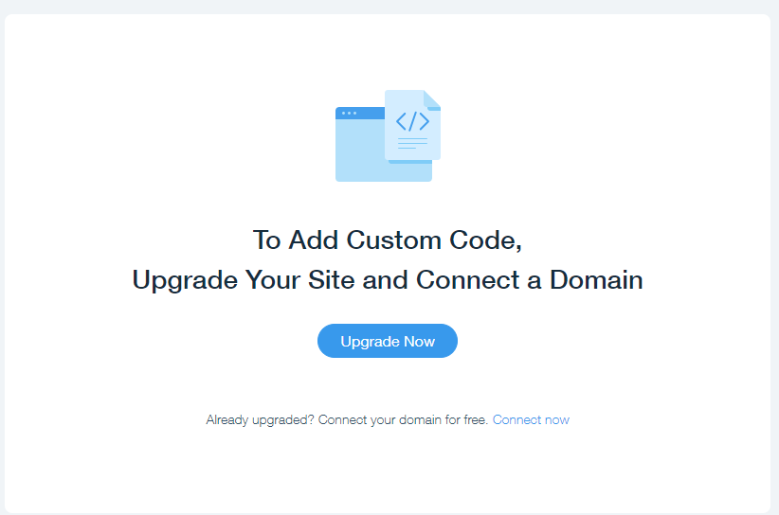
Java Script
Java script implications was not available on the free software used but a live chat feature would have been added to make for a simple and easy experience if the user had any issues

Slide 31
Production Log
LAC – Produce a website for a specific purpose and audience.

Slide 32
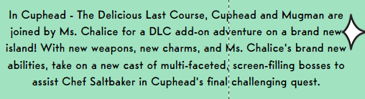
Proof Reading
I have proofread and corrected all text available on this website to keep a professional look to the website and doesn't take away from the user's experience and makes it simple to read for everyone

Slide 33
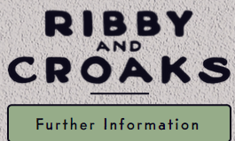
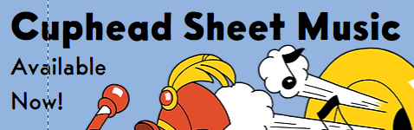
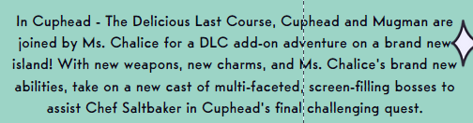
Formatting and Styling: Apply consistent formatting and styling to the text, that are readable and visually appealing.
The titles have used the font "Cuphead felix regular" this has been chosen because of its striking look and how it stands out from the rest of the fonts chosen drawing attention to it while also fitting the theme of frantic yet calculated music
The fonts "cuphead vogue bold" has been used for all block text because of its simples to read nature, visual appeal and 1930s look to it. This block text has been formatted to the center to make is stand on its own in the design
For headers "cuphead vogue extra bold", this was chosen to because of its similar look to the "cuphead vogue bold" which makes them seem connected and more coherent

Slide 34
Information – Clear and concise no unnecessary jargon
I have tried my best to avoid jargon only leaving those used by the Cuphead songs/game such as the title of a song which the audience will be formular with, this has been done to make my website simple to understand for all users.

Slide 35
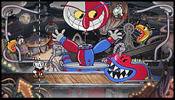


Image Selection
I have chosen to use these images because of there connection with the game, they perfectly fit there style chosen by the developers of a colorized rubber house look while still fitting the themes of a newspaper from the same era. The colours chosen (such as mint green) have been selected due to there constant use in the developers advertisements for examples in there advertisements for "the delicious last course" a DLC which further expanded on the musical style of the game along with its art

Slide 36
File Compression and Optimization: Compress image files to optimize their size without significantly compromising quality. This helps reduce loading times on websites or applications and ensures a smooth user experience.
Format | Use
JPG | These have a small files size with limited quality and are often used on websites, this is because the space taken up by them is much lower, JPEG use lossy compression meaning that when the image is compressed it losses quality.
PNG | These have reasonably good quality with a smaller file size, so it in-between a TIFF/JPEG and are good for use online. PNGs uses lossless compression meaning they can be compressed without losing clarity unlike JPEGs.
TIFF | These files are the best quality possible in an image but because of this they have an extremely large file size, I have avoided using these because of the large file size which will make using the website feel sluggish. TIFFs use lossless compression
PDF | These are smaller files sizes and are often used as a file to be referenced to through a link such as a menu on a website or a letter. These are not often used for online content or images.

Slide 37
Item under test | Does it work as expected? Yes / No | Comments
Functionality | yes | The website is displayed correctly with no issues with placement or use
Page Content displayed as intended | yes | The pages have images an text load correctly without visual issues such as blurring
Links working | yes | Links lead to external and internal website
Alt tags | yes | Alt tags work so that users with visual impairments are able to use the website with ease through the use of a screen reader
Suitable user experience | yes | I feel my website has a good user experience for my audience because I stuck to a theme that was fitting for the focus of the website and the audience it has
Video | yes | The video plays, pauses and stops depending on the users actions
Form completion | yes | Users are able to sent forms through the website with a complition message appearing once done

Slide 38




How have you maintained consistency throughout your website and why?
When creating this website, I tried to keep a consistent look to it to not confuse the user when navigating. The navigation bar has been placed on the top of the website along with following the user as the scroll to make it easy for them to navigate around it making for a much better user experience and taking away the tedium of having to scroll up when wanting to change content. The fonts used on each page of the website have been kept consistent to make for a smoother reading experience and so the user can easily adjust to text, these text choices have been chosen because of their look (san-serif or serif) and their readability at a distance along with how they fit within the ascetic of the website. The decoration / look of the website is kept consistent so it isn't jarring for the users to change from page to page along with adding to the 1930s look of the website. I have chosen to use colours that are consistent with the pastel themes shown through other marketing for "Cuphead" these colours have been chosen to keep a consistant look to the website but letting the pages stand out and feel their own, along with being able to connect buttons to images through placement and colour.

Slide 39
Evidence your website by screen shots.

Slide 40


Import slide show remove all arrows and change bg to mint green
Add custom arrows, links and images to fill the slide with relevant information

Slide 41


Insert box with blue background, place box with in colour and black outline (curved corners) behind it
Add in text image and button to buy (leads to store page)

Slide 42

Bring in cuphead logo and cuphead and mug man heads to use as a header for the website, add text with studio name and price of game, add lines to mimic 1930s newpaper
Use as actual header holding navigation bar for the website, use Cuphead Memphis medium to further mimic the look of 1930s newspaper, add basket and user profile to that user can navigate to basket when ordering.

Slide 43





Use button with colour connecting to the colours used in the charecters
Create title using size to enfersize name
Place all character from that level into frame (with sections leaving the box
Repeat with other charecters
Crop background of battle to act as a backdrop for charecters

Slide 44

Video placed azt top of gallery
Use as title bar for page, holds title of website, title of page and game release date. Mimics 1930s newspaper

Slide 45


Create ticket shape in photoshop
Edit the forum addition to remove background and fit will into the ticket shape, make button red to fit with brand recognition

Slide 46


Same title as on gallery
Images taken from the game with back bg to avoid getting lost in background
Orange background to fit with characters
Additions of line to help mimic 1930s newpaper
Use same image layout as in gallery

